Slide 1
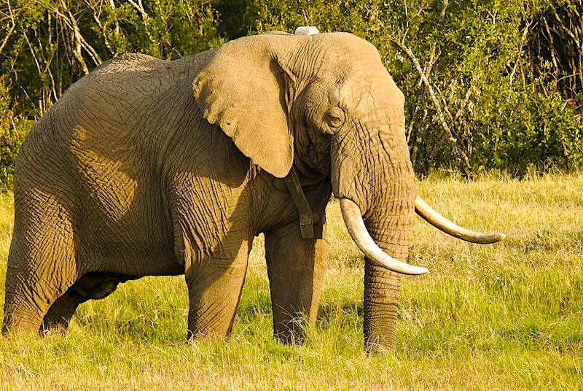
AEAP Objective 7: Improved Local Communities’ Cooperation and Collaboration on African Elephant Conservation
Strategy 7. Devise/improve and implement sustainable
incentive schemes to benefit local communities

Slide 2
DECLARATION Voices of the Communities: A New Deal for rural communities and wildlife and natural resources Victoria Falls, Zimbabwe 24-25 June 2019
We are not helpless communities. We have strong capacity to take this New Deal forward ourselves, if our rights of ownership, governance and use of our natural resources are recognized and respected, as share-holders and not mere stakeholders.
We therefore invite you the Heads of State and governments in Africa together with the private sector and international organizations to recognize the role of communities in the ownership, management and conservation of natural resources that drives the wildlife economy across Africa and to address our concerns.

Slide 3
Elephant Range and Numbers
500 A.D.
2020

Slide 4
We know what the elephant in the room is

Slide 5
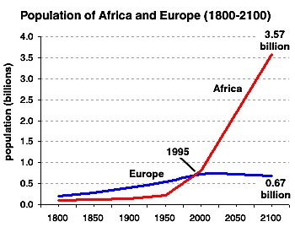
Africa Human Population Growth
Year Population
1800 – 200 million
2020 – 1.3 billion
2100 – 3.6 billion

Slide 6
As population grows, humans move into wildlife habitat
The Cow
And the Plough

Slide 7
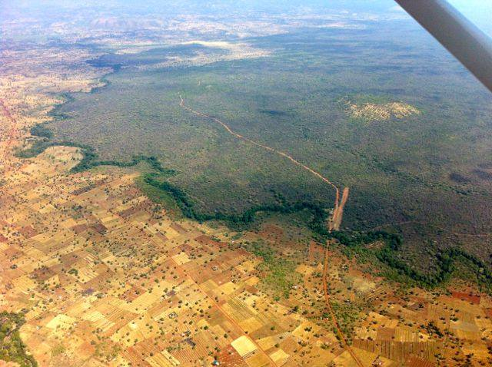
Islands of wildlife habitat surrounded by people

Slide 8
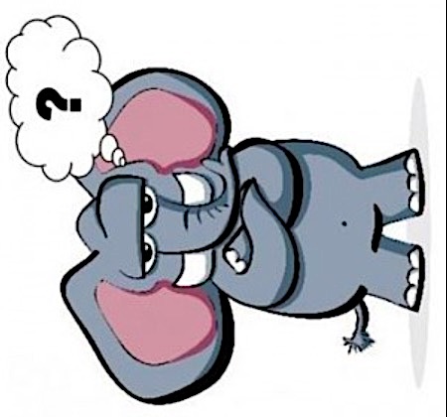
What can prevent the cow and the plough from taking wildlife habitat?

Slide 10
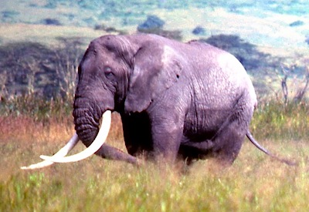
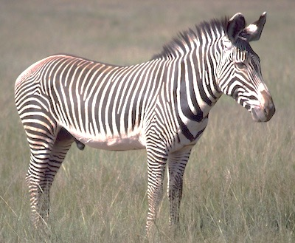
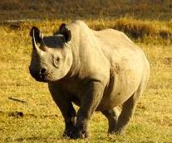
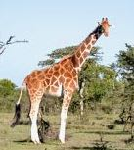
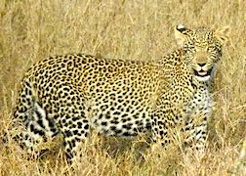
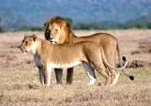
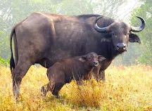
Wildlife has to become the economy

Slide 11
Activities 7.1.1. Identify and assess needs for the full participation of local people to conserve the African elephant.
Activity 7.1.4. Develop innovative incentive schemes that increase benefits to local communities, while simultaneously reducing costs of living with elephants.
Activity 7.1.5. Assess and promote, as appropriate, consumptive and non-consumptive use of elephants and the sharing of benefits accrued with affected communities. [Not always top down, communities can produce and they share, bottom up]

Slide 12
7.1.1. Identify and assess needs for the full participation of local people to conserve the African elephant.
Start with these from the Voices of the Communities Declaration:
Achieve self-determination and security of rights and tenure
Recognize community rights over the ownership, management and use of resources
There is a need first for enabling legislation and then to delineate territories over which defined community groups have natural resource user and management rights. Everything else follows from this.
These community Wildlife Economic Zones should be coordinated to satisfy the strategies described under the AEAP Objective 2:
MAINTAIN ELEPHANT HABITATS AND RESTORE CONNECTIVITY

Slide 13
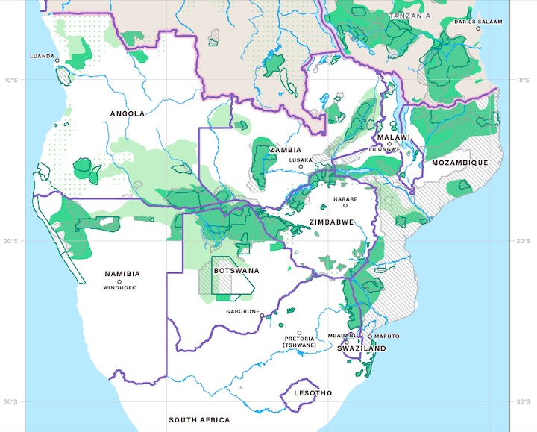
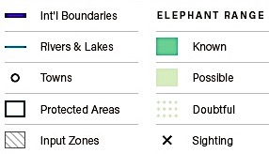
For example, Southern Africa

Slide 14
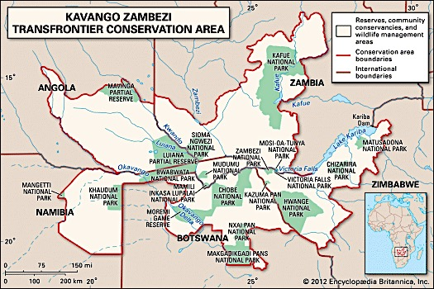
KAZA – how to connect the parks?

Slide 15
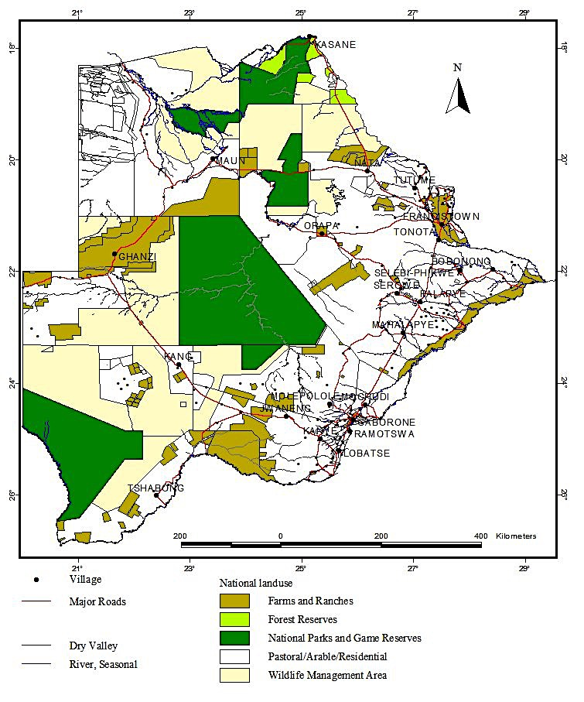
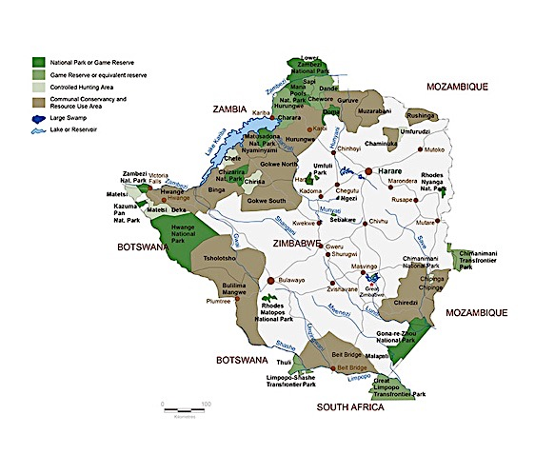
Examples

Slide 16
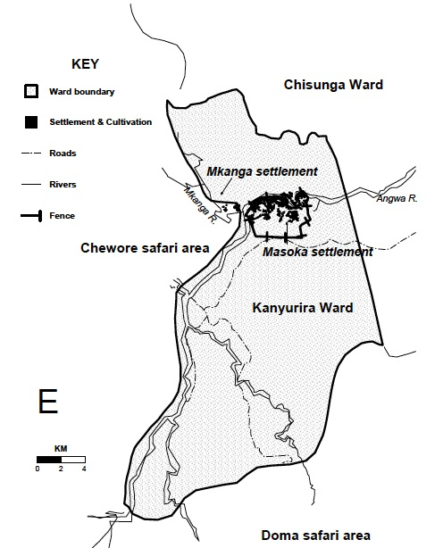
Masoka
CAMPFIRE

Slide 17
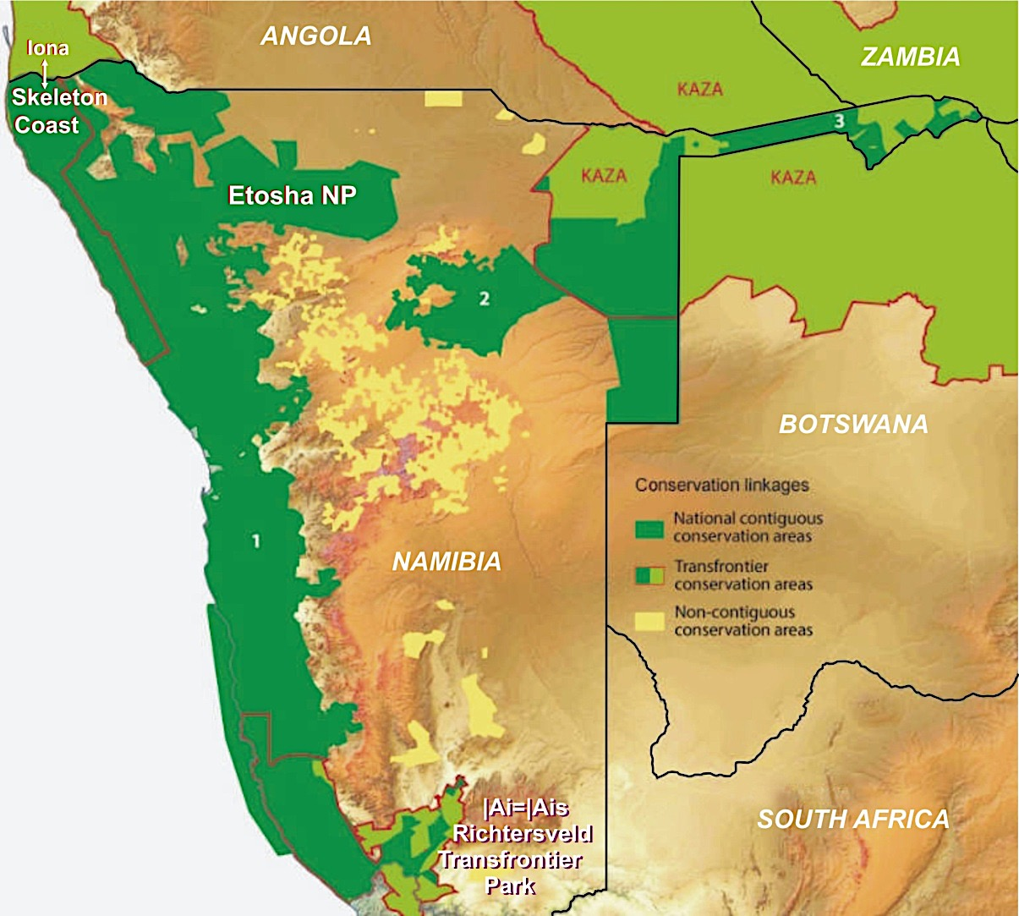
NAMIBIA

Slide 18
Up to 1960 wildlife was “owned” by the State.
9,000,000
Landholders were expected to support wildlife on their land, but had no rights to use it or benefit from it.
8,000,000
7,000,000
In response to wildlife decline and growing dissatisfaction, a new approach was introduced.
6,000,000
ANIMAL NUMBERS
5,000,000
In the 1960s and 1990s, conditional rights over the use of wildlife were devolved to private and communal farmers.
4,000,000
3,000,000
The laws gave the same rights to farmers in both land tenure systems.
2,000,000
1,000,000
This policy shift led to a radical change in attitude.
1770
1820
1870
1920
1970
2020
Wildlife suddenly had value
YEAR
Figure 1: Wildlife numbers from about 1800 to 2015
Wildlife could be used to support a multi-faceted business model, including trophy hunting, meat production, live sale of surplus animals and tourism.
It could be part of a conventional livestock farming operation, or be a dedicated business on its own.
As the sector developed, farmers discovered that they could do better from wildlife than from domestic stock.
Livestock numbers declined on freehold farmland while wildlife numbers increased.
Today there is more wildlife in Namibia than at any time in the past 150 years with latest estimates putting the national wildlife herd at over 3 million animals

Slide 19
The problem is essentially one of lack of knowledge.
People think that they are doing what is best for conservation, but they simply do not understand the economic drivers for wildlife and biodiversity conservation in biodiversity-rich and rainfall-poor developing countries.
3,000,000
NAMIBIA
And many African countries are sadly falling into the same trap.
2,500,000
Kenya, for example, with its protectionist conservation approach, has less wildlife today than at any time in its history.
2,000,000
WILDLIFE NUMBERS
1,500,000
1,000,000
KENYA
(Figure 2)
500,000
We need to share knowledge
1960
1970
1980
1990
2000
2010
2020
YEAR
Figure 2: Wildlife numbers in Kenya from
1960s to 2010s (from Ogutu et al. 2016)

Slide 20
The message is powerfully explained using the simple diagram below ─
Conventional farming –
exotic species
s
production, e.g. domestic stock & crops
t
Markets work against the
i
f
e
conservation of wildlife
n
e
and natural ecosystems
b
r
e
h
Cross-over point
at about 800mm
t
o
d
n
a
e
Wildlife management
–
m
indigenous species production
o
Markets work for the
c
n
conservation of wildlife
I
& natural ecosystems
0
0
0
0
0
0
0
0
0
0
0
0
0
0
0
0
0
0
0
0
0
0
0
0
0
0
0
0
0
0
0
0
0
0
0
0
0
0
0
0
0
1
2
3
4
5
6
7
8
9
0
1
2
3
4
5
6
7
8
9
0
1
1
1
1
1
1
1
1
1
1
2
Rainfall (mm) - a good proxy for land productivity
Figure 3: Economic returns to conventional farming (yellow line) and to wildlife management (green line) in areas of different land productivity, with rainfall being a good proxy for productivity

Slide 21
Returning to the diagram …
Conventional farming –
exotic species
production, e.g. domestic stock & crops
s
What if wildlife value increases?
t
Realm where
conventional farming
outcompetes wildlife
i
f
e
n
e
b
r
e
The cross-over point of the two
curves moves upwards and to the right.
Wildlife becomes more competitive as a
land use displacing conventional farming over
a greater area extending into higher rainfall regimes ─ opening up more habitats and including more species.
h
t
o
d
Wildlife management
–
n
a
indigenous species production
e
m
Realm where
wildlife management
outcompetes farming
o
c
n
I
0
0
0
0
0
0
0
0
0
0
0
0
0
0
0
0
0
0
0
0
0
0
0
0
0
0
0
0
0
0
0
0
0
0
0
0
0
0
0
0
0
1
2
3
4
5
6
7
8
9
0
1
2
3
4
5
6
7
8
9
0
1
1
1
1
1
1
1
1
1
1
2
Rainfall (mm)
Figure 4: Economic returns to conventional farming and to wildlife management in areas of different land productivity, with rainfall being a good proxy for productivity

Slide 22
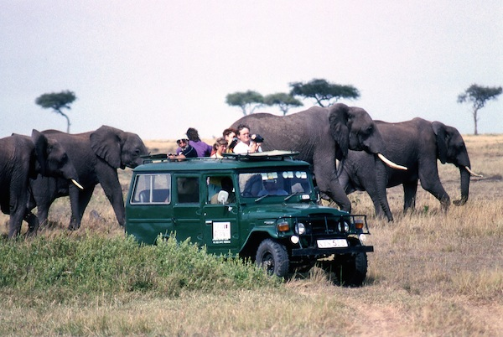
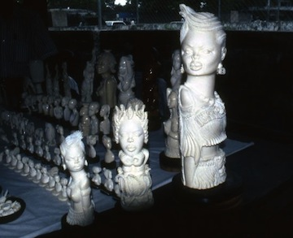
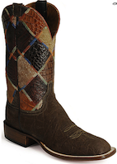
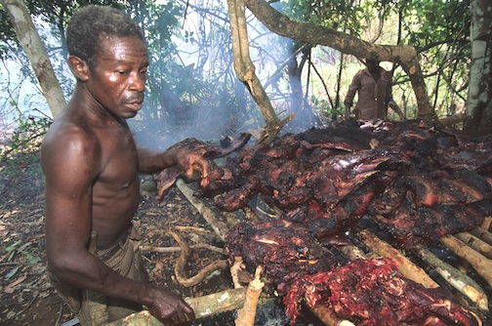
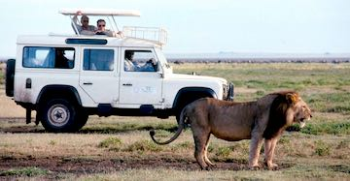
A wildlife economy can be a mix of photo-tourism and consumptive use

Slide 23
Nature Based Tourism

Slide 24
Protected Areas

Slide 25
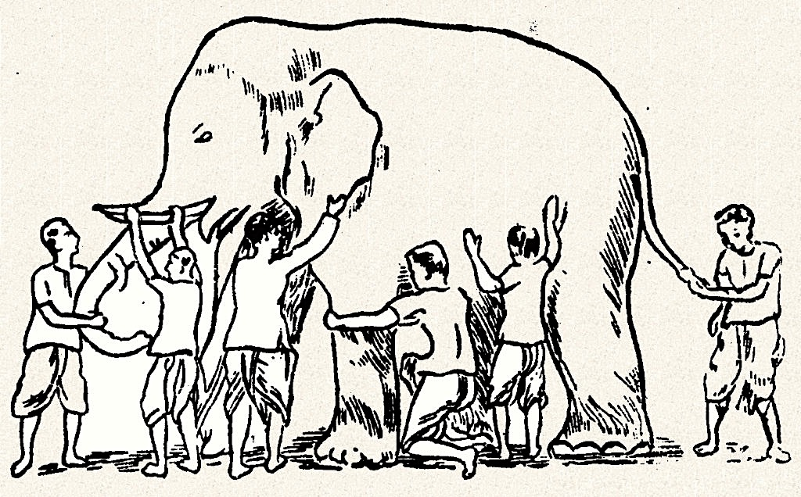
Many parts of the elephant have value

Slide 26
Elephant-based livelihood streams
Raw ivory sales
Ivory craft
Meat
Hide, either tanned sale or small industries (boots, belts, etc.)
Tail-hair bracelets
Feet – stools, recepticles
Ears – quality drum tops

Slide 27
Minimum economic value of 4-tonne old bull elephant (post-tourism value)
At the gate: USD
50 kg raw ivory 10,000
1000 kg dried meat 3,000
Tanned leather (2 m²) 500
Tail hairs 100
Other parts 400
TOTAL 14,000
If value added industries are developed, much more

Slide 28
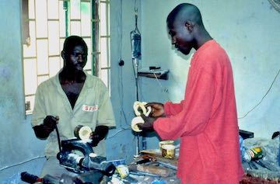
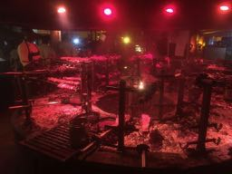
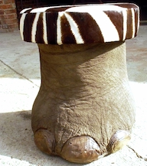
The employment potential is substantial
Ivory carving
Bushmeat restaurants
Leather
Tourist crafts

Slide 29
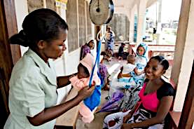
Income from wildlife can provide
Poverty reduction
Education
Health
Clean water
Small business development
Social cohesion
Wildlife conservation

Slide 30
Environmental Advantages of a Wildlife Economy

Slide 31
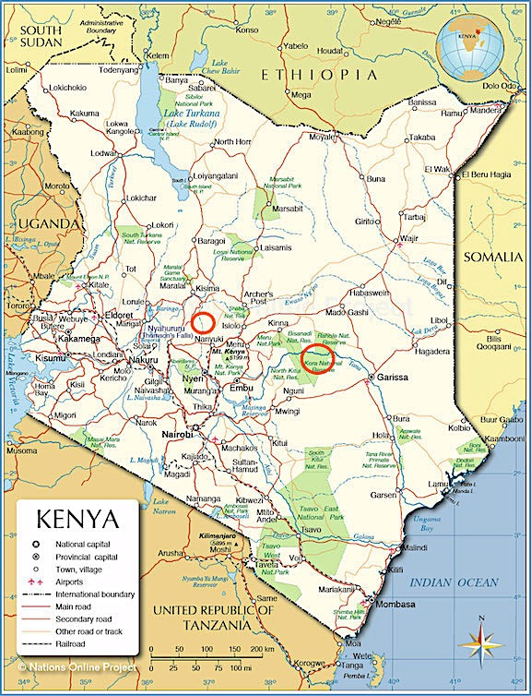

Slide 32
Danger – road to extinction

Slide 33
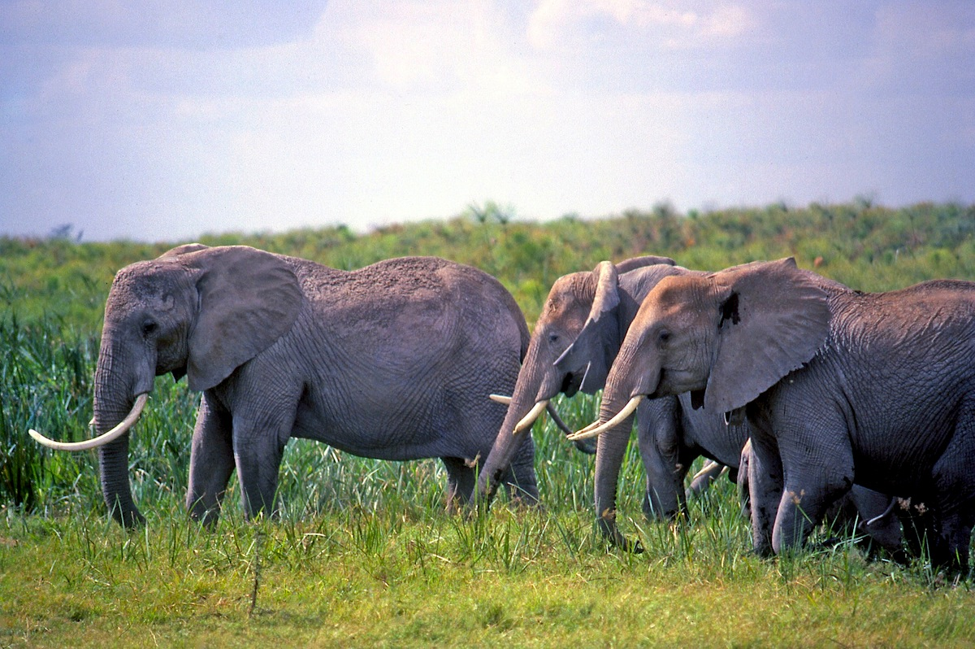
The End (Hopefully not)

